Slide 1

Detecting Recon Attacks
on IoT Devices – Sprint 2
// Domenico Fumagalli

Slide 2
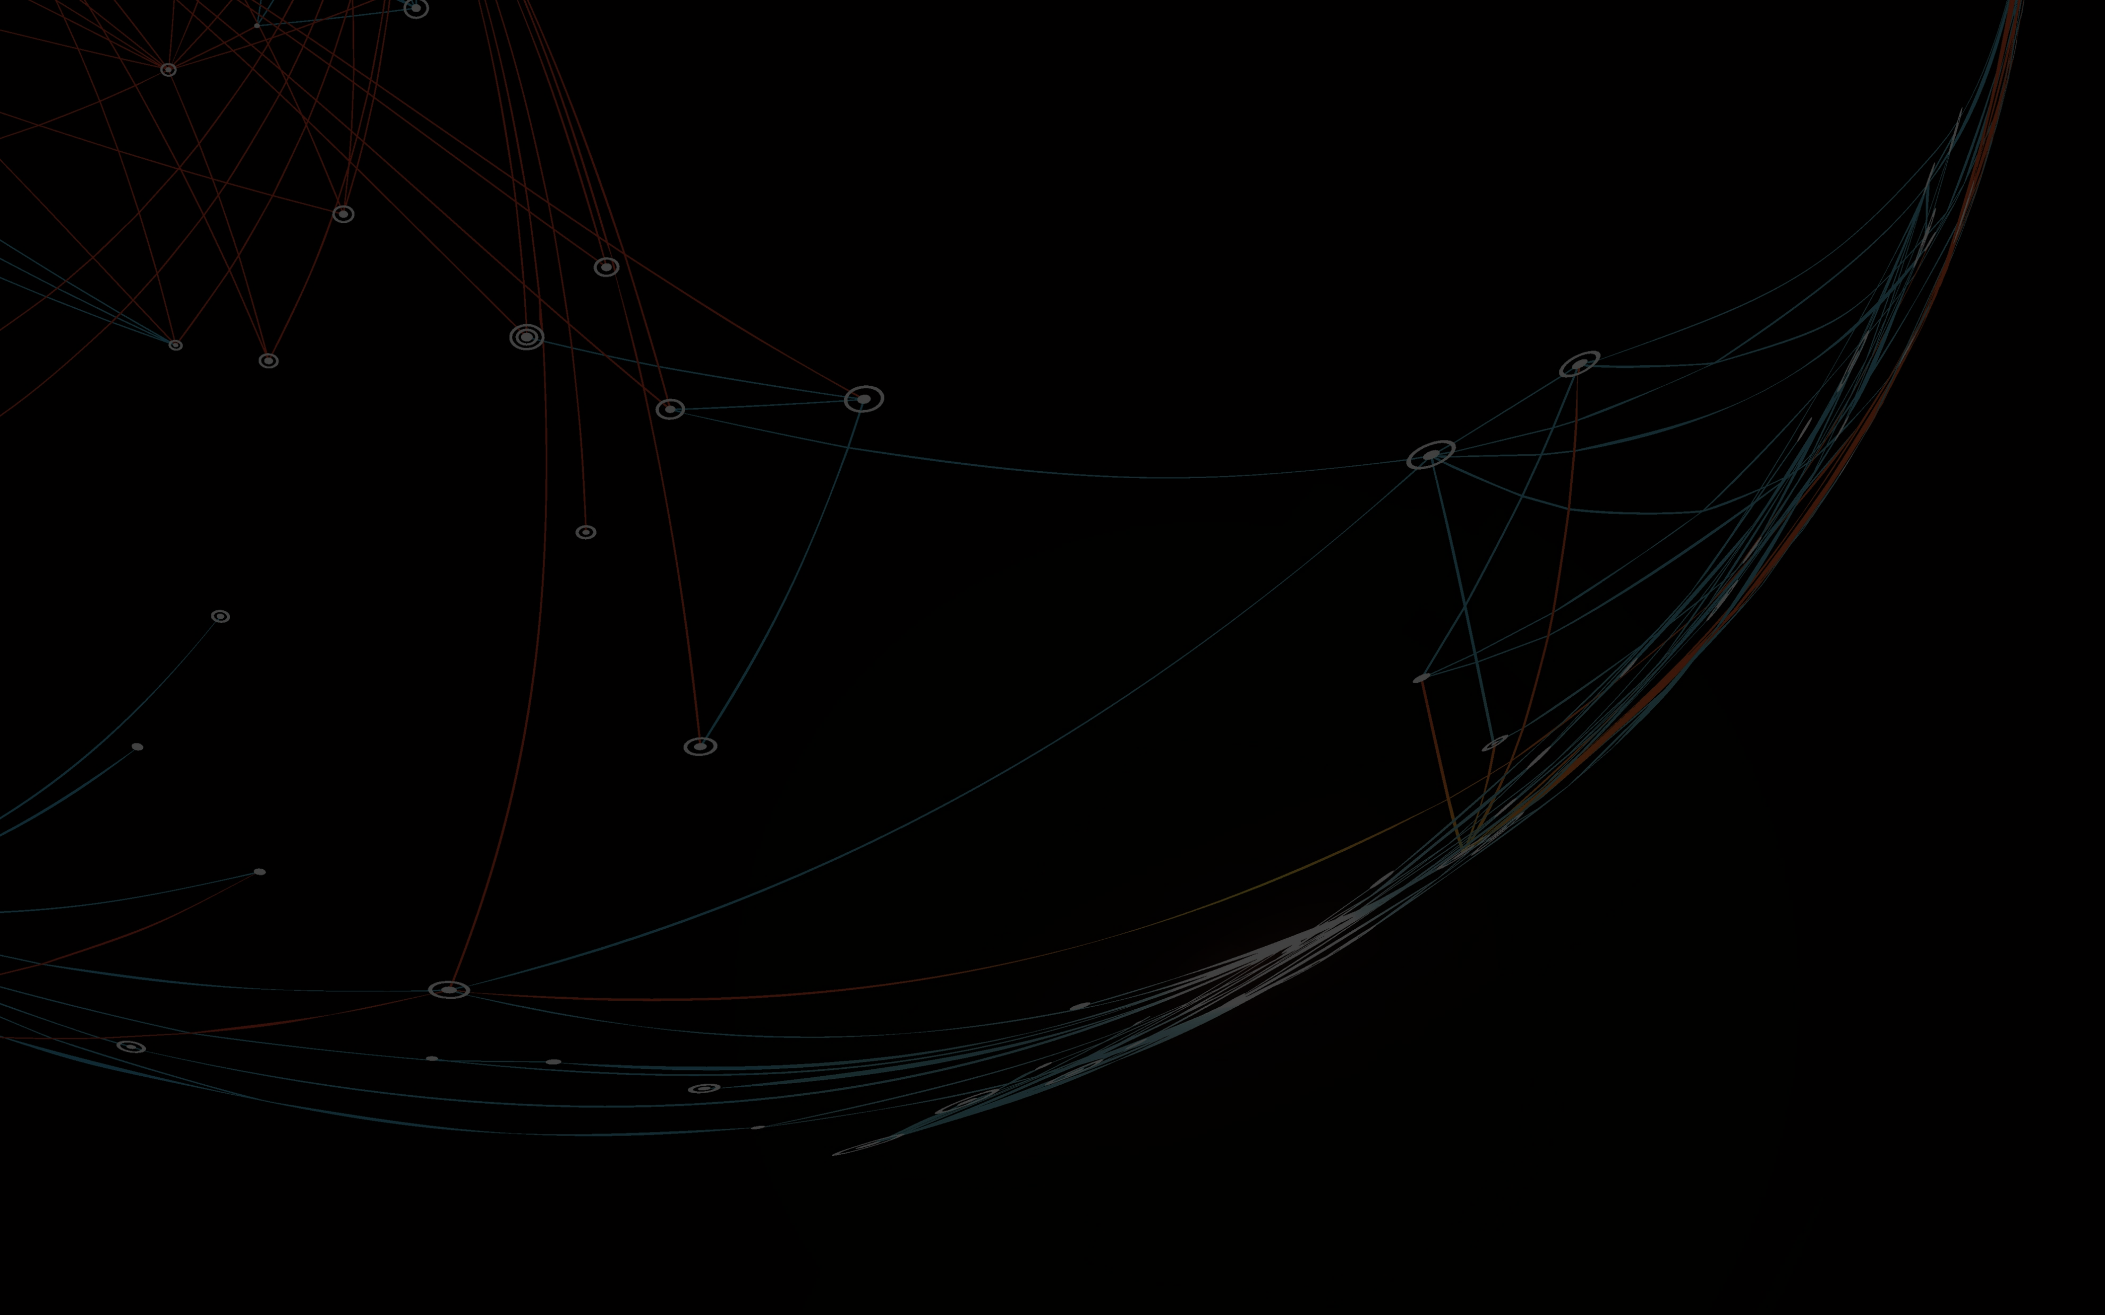
Sprint 2 Objectives
2020
2025
Global data generated by IoT Devices
Global data generated by IoT Devices
17.3 ZB
73.1 ZB
Sharpen EDA
Preprocess data
Develop simple models for binary classification

Slide 3




The Dataset Preprocessing Steps
47 features
40 M rows

Slide 4

The Dataset
47 features
30 features
40 M rows
1.5 M rows
Filter on recon
Optimize dtypes
Truncated SVD

Slide 5
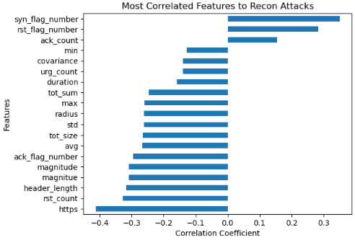
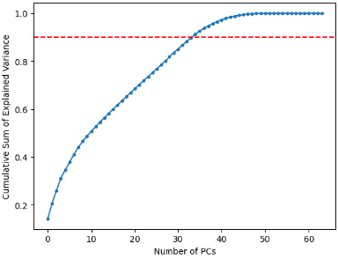
Assessing feature importance
I’m coming back for ya’all

Slide 6
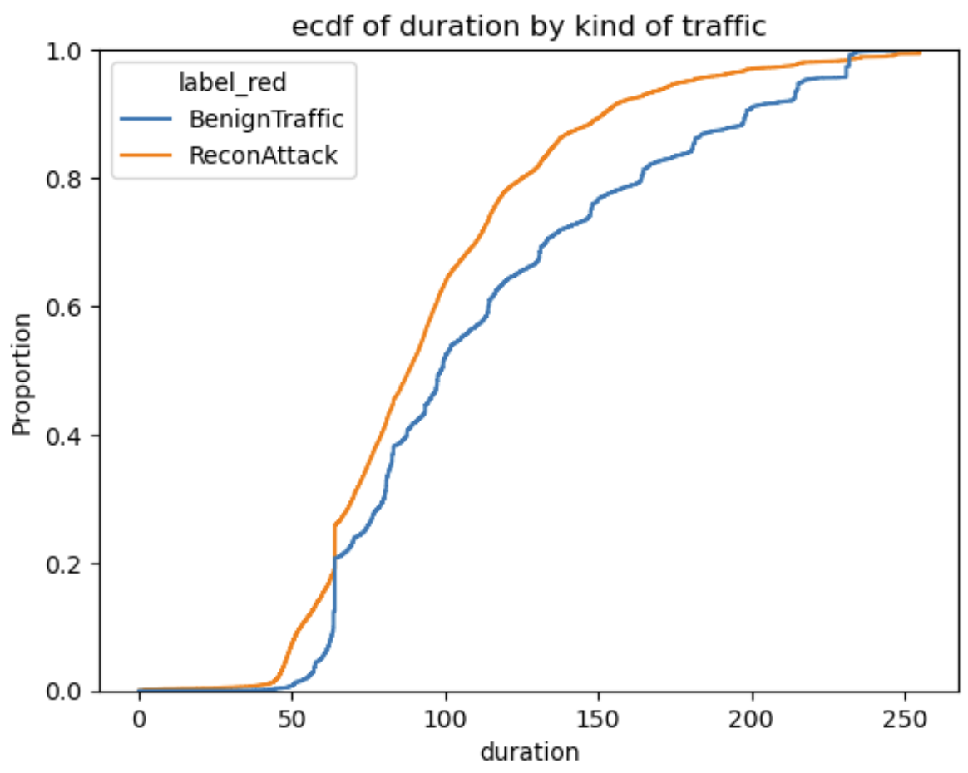
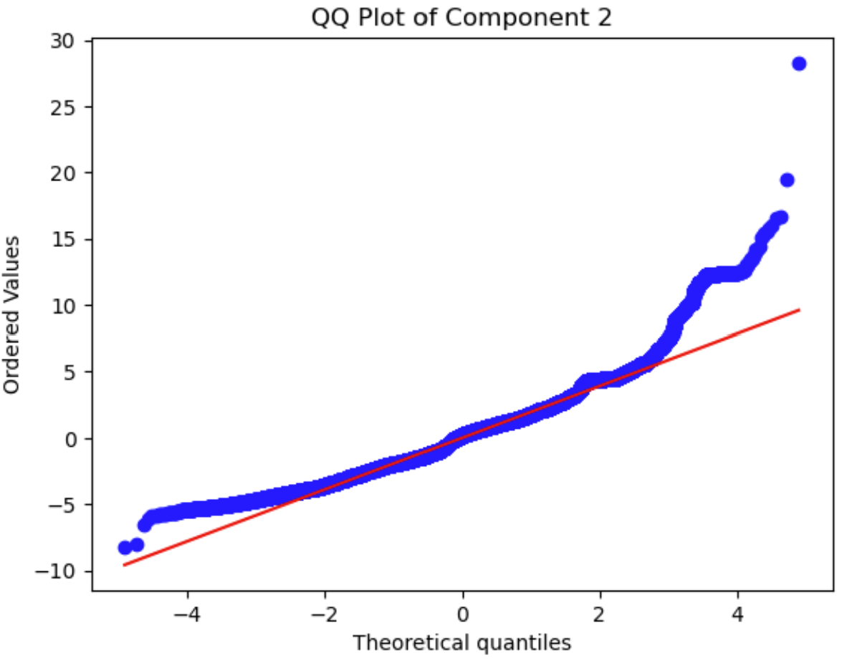
Understanding distribution

Slide 7
Modelling Pipeline
SMOTE
RandUndersampler
Address class imbalance
Standard Scaler
Reduce size
Make the dataset more information-dense
Truncated SVD
Logistic Regression
Linear SVC
Decision Tree

Slide 8
First Results

Slide 9
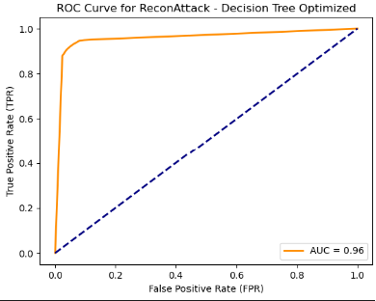
Optimizing Decision tree
By optimizing for precision hyperparameter we were able to gain 3 points.
All other hyperparameters stayed the same.

Slide 10

Conclusion and Next Steps
After addressing successfully class imbalance we can focus on more advanced models and optimization.
Bigger resources are really needed for this project, we will try the AWS free tier.
Next sprint will be about fine-tuning binary and start addressing the prediction of the surface of attack.

